Slide 1

BERT-based Cohesion Analysis of Japanese Texts
2022.01.28.
DongHyun KIM
gmr4rnjs@gmail.com

Slide 2

Contents
Introduction
Proposed Method
Experiments
Conclusion

Slide 3
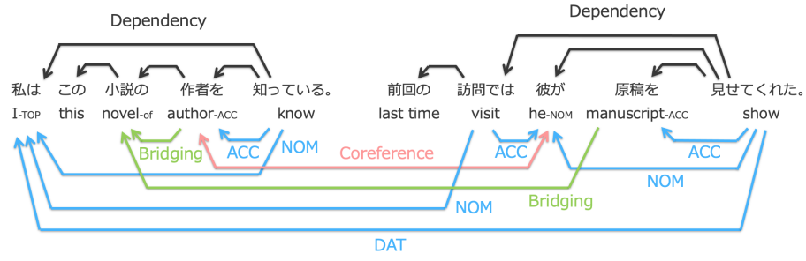
Introduction
Relations among various entities
The meaning of natural language text is supported by cohesion among various kinds of entities.
Cohesion includes CR, PAS and BAR.
Among these relations, PAS of nominal predicates and BAR have not been studied well.
Notes:
Accusative : 직접 목적격
Nominative : 주격
Dative:여격(명사·대명사·형용사가 간접 목적어이거나 간접 목적어와 관련될 때 취하는 형태)

Slide 4
Introduction (Cont.)
VPA, NPA, BAR, CR
VPA : Verbal Predicate-Argument
NPA : Nominal Predicate-Argument
BAR : Bridging Anaphora Resolution
CR : Coreference Resolution
Contribution
In this paper, A framework for analyzing multiple semantic relations included in cohesion by using BERT
Focusing on the differences of coreference resolution from other semantic tasks and demonstrated that it is effective to treat CR specially.
Notes:
A coreference relation is a relation between nouns that refer to the same real-world entity, and the task of revealing this relation is called coreference resolution (CR)
A predicate-argument structure consists of a predicate and its arguments that fill each case of the predicate, such as who does/did what to whom.

Slide 5
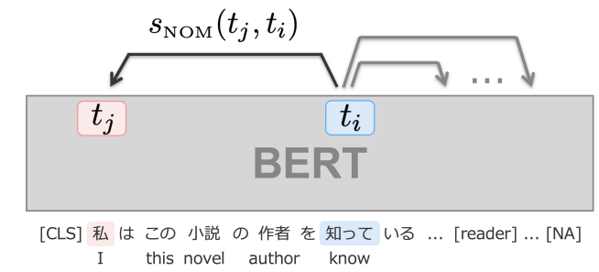
Proposed Method
Base Model
The analysis of nominative
The highest probability among them is adopted as the NOM(ACC, DAT) argument of t.

Slide 6
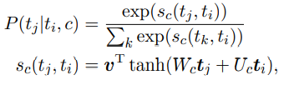
Proposed Method
Base Model
Input Representation
Insert [CLS] and [SEP] tokens at the beginning and end of a document.
In addition, [author], [reader], [unspecified person], [NULL] and [NA].
[author], [reader], and [unspecified person] are taken into consideration as the targets of exophora.
Output Layer
Using Multi Layer Perceptron(MLP), calculating the probability of output.
Notes:
Wc and Uc are weight matrices for each relation, and v is a weight vector shared across relations. ti and tj denote hidden vectors of the BERT’s final layer corresponding to the subword ti and tj .

Slide 7
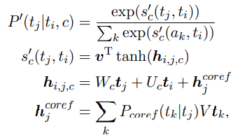
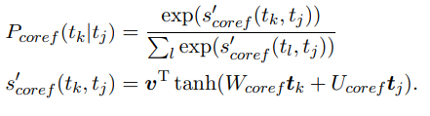
Proposed Method
Coreference – aware Cohesion Analysis Model
In the first step, it performs only CR.
This is calculated in the same way as Base Model.
Notes:
e V is a weight matrix shared across relations and ti , tj , and tk denote hidden vectors of the BERT’s final layer corresponding to the subword ti , tj , and tk. Pcoref (tk|tj ) is the output of the first step and represents the probability that tj has a coreference relation with tk. This is calculated in the same way as Base Model as follows:

Slide 8
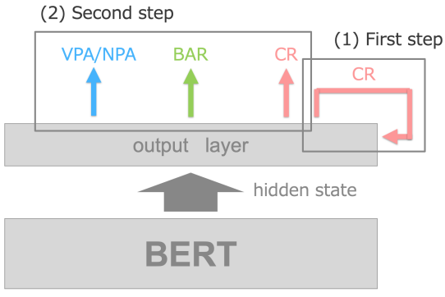
Proposed Method
Coreference – aware Cohesion Analysis Model
In the second step, it analyzes all tasks using the CR results obtained in the previous step as features.
Notes:
e V is a weight matrix shared across relations and ti , tj , and tk denote hidden vectors of the BERT’s final layer corresponding to the subword ti , tj , and tk. Pcoref (tk|tj ) is the output of the first step and represents the probability that tj has a coreference relation with tk. This is calculated in the same way as Base Model as follows:

Slide 9
Experiments
Experimental Settings
In experiments, CAModel, CorefCAModel is used.
Two kinds of dataset is used, One is the Kyoto University Web Document Leads Corpus, the other is the Kyoto University Text Corpus.
In these two dataset, relations are manually annotated.
BERT
NICT BERT is used, this model was trained after morphological and subword segmentations.
Using the full text of Japanese Wikipedia form approximately 1 million steps.

Slide 10
Experiments
Experimental Step
For VPA, all entities are extracted, and analyzed them in terms of four cases of NOM, ACC, DAT and NOM2.
For NPA, we analyzed nouns that KNP judged to have arguments, that have case or zero relations for training and evaluation.
For BAR&CR, they are considered author, reader, and unspecified person as targets of exophora.

Slide 11
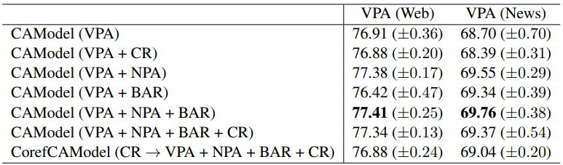
Experiments
Results

Slide 12
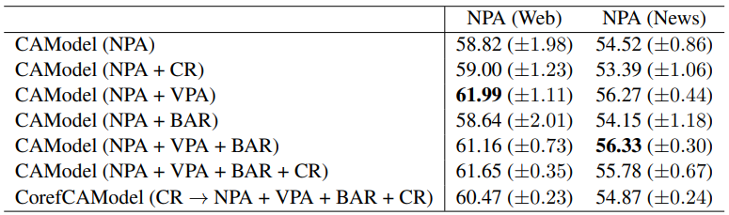
Experiments
Results

Slide 13
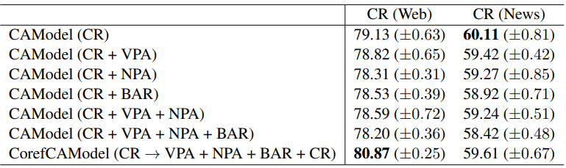
Experiments
Results

Slide 14
Experiments
Discussion
The results show that VPA, NPA and BAR are generally beneficial mutually in multi-task learning.
But CR reduces the F1 score of VPA and BAR, so no benefit of multi-task learning.
Therefore, CR should be treated differently from VPA, NPA, and BAR. In this paper, CorefCAModel is proposed. It performs only CR first and uses its results as features for all the tasks(VPA, NPA, BAR).

Slide 15
Experiments
Discussion
The results show that VPA, NPA and BAR are generally beneficial mutually in multi-task learning.
But CR reduces the F1 score of VPA and BAR, so no benefit of multi-task learning.
Therefore, CR should be treated differently from VPA, NPA, and BAR. In this paper, CorefCAModel is proposed. It performs only CR first and uses its results as features for all the tasks(VPA, NPA, BAR).

Slide 16
Conclusion
In this work, the multi-task learning of cohesion analysis including verbal predicate-argument structure analysis, nominal predicate-argument structure analysis, coreference resolution, and bridging anaphora resolution using BERT is proposed.
Plus, coreference resolution is different and should be treated specially.

Slide 17
Thank you for listening

